Slide 1
SafeMe
By –
Sawan P.-45
Esha G.-72

Slide 2
Introduction
In today’s world safety and security is need of the hour parents being able to keep their children safe ,friends being able to look after each other in places away from their home its absolutely necessary to have security tools that in time of crisis can make a difference.
That’s why I created SafeMe is an android app which can instantly alert the Guardians (along with user location) whenever the user is in an emergency situation. It can be triggered just by shaking the android device in which the app is installed or by using the Alert widget module or
A various number of task specific features designed to keep the users safety at utmost importance.

Slide 3
Scope
Having application which tries to ensure your privacy and safety is a must. This android application tends to provide that safety to user.
Users can shake the device to activate emergency protocol.
A specific database setup to upload Image evidence to secure cloud server for safe keeping.
Instant spam able help widget on home screen.
Up to two emergency contact can be setup.
In this fields noting can be too perfect but this app tried to cover all the required fields such as location tracking, internet messaging, text messaging, Emergency Calling.

Slide 4
Scalability
features that can be added are on body off body detection
More precise location tracking
Developing a help chatbot to navigate for disabled individuals.
Adding groups for friends which can only be applicable to people surrounding you.
Spam able notification feature to request for help. From being generic in terms of its shake detection algorithm it can scale to be unique to each individual device and usage of that individual

Slide 5
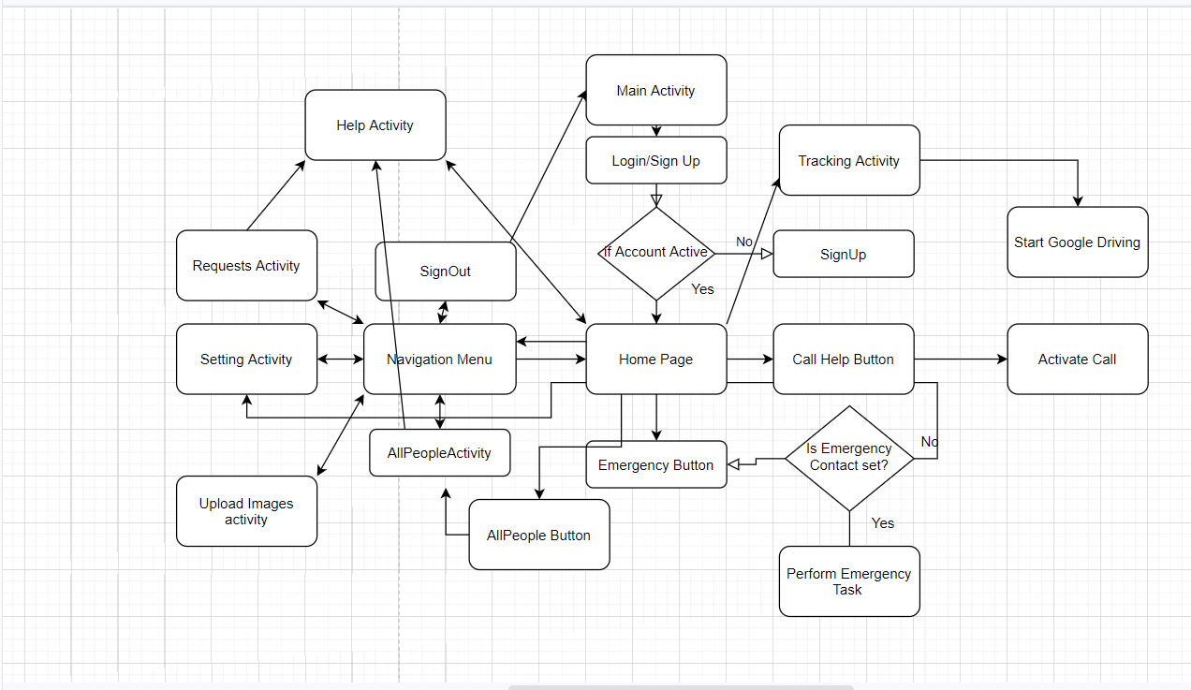
Flowchart
Simplistic Flow chart of current system-

Slide 6

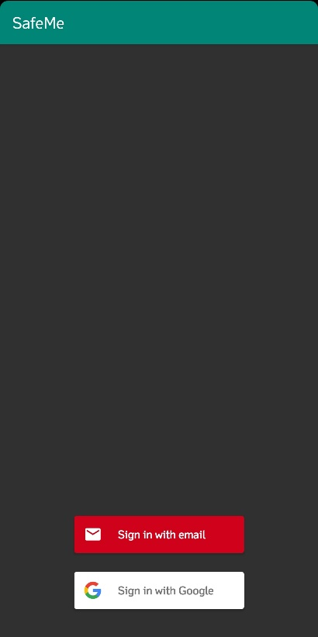
MainActivity & LoginActivity

Slide 7
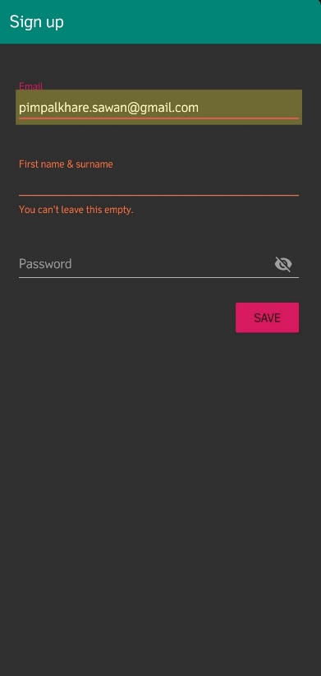
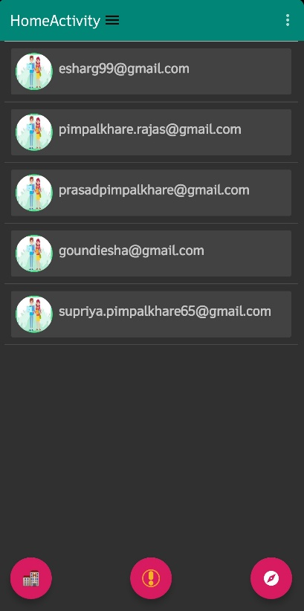
SignUp Activity & Home Activity

Slide 8
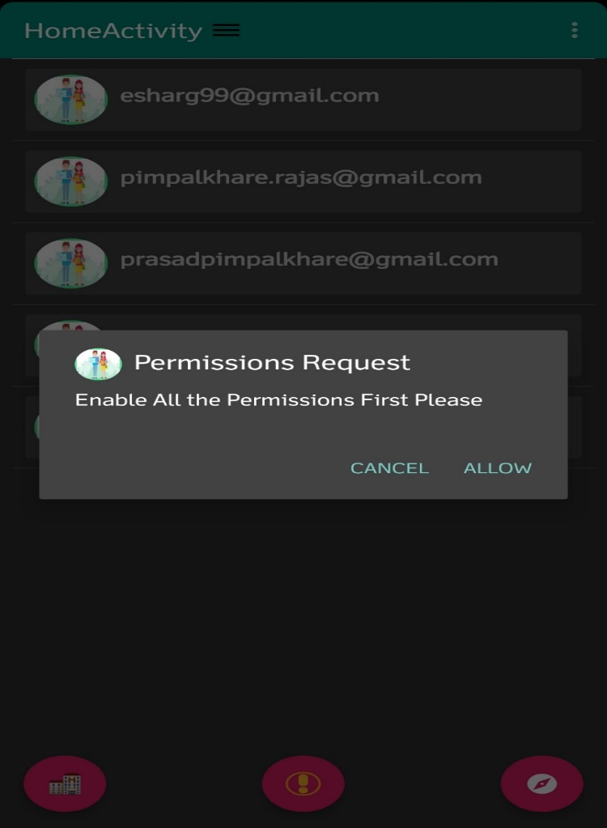

Request Permission Alert Box & Toast Maker Sensor Detection Text

Slide 9
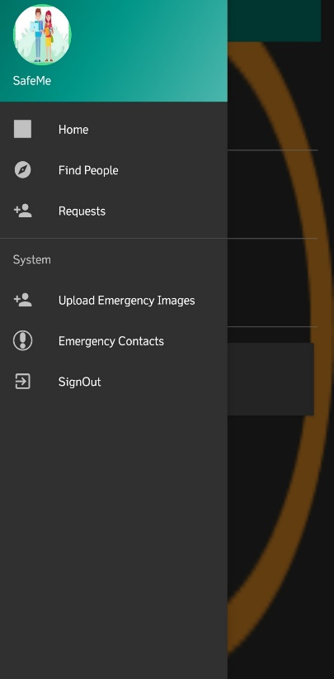
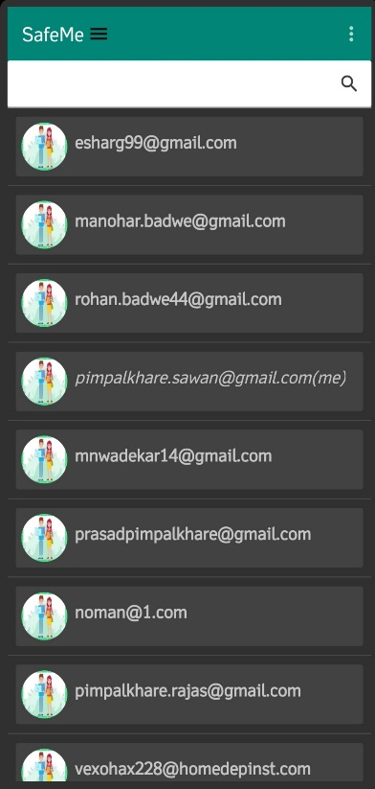
Navigation Drawer & All People Activity

Slide 10
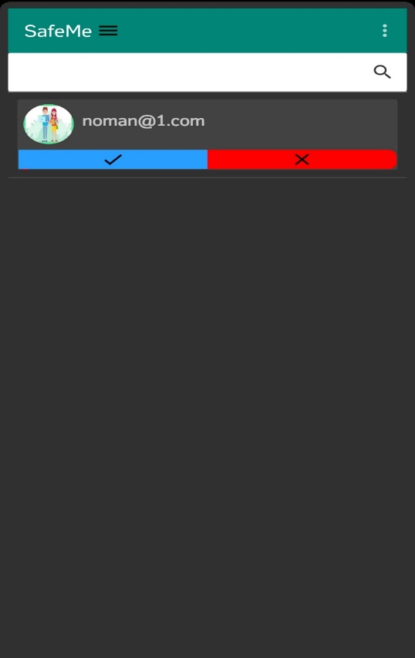

Friend Request Activity & Notification for Friend Request

Slide 11
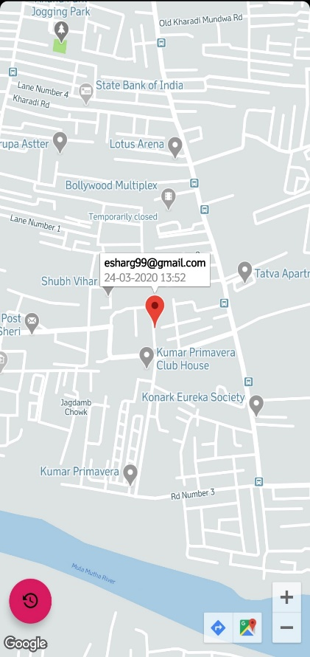
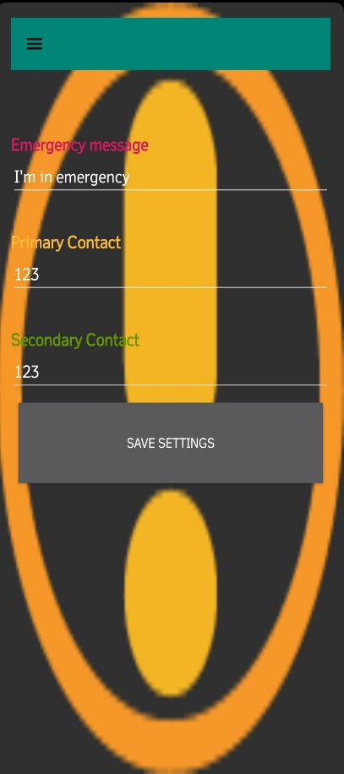
Tracking Activity & Settings Activity

Slide 12

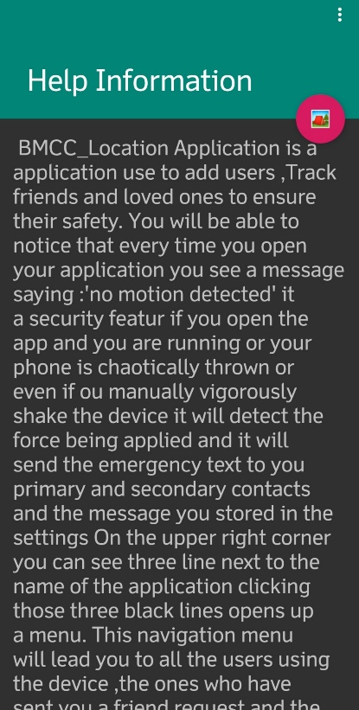
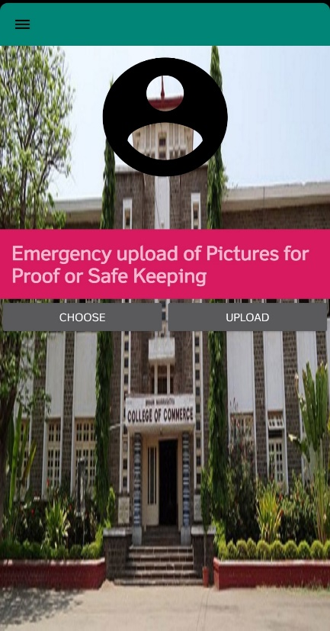
Help Activity & Image Upload Activity & Home Widget

Slide 13
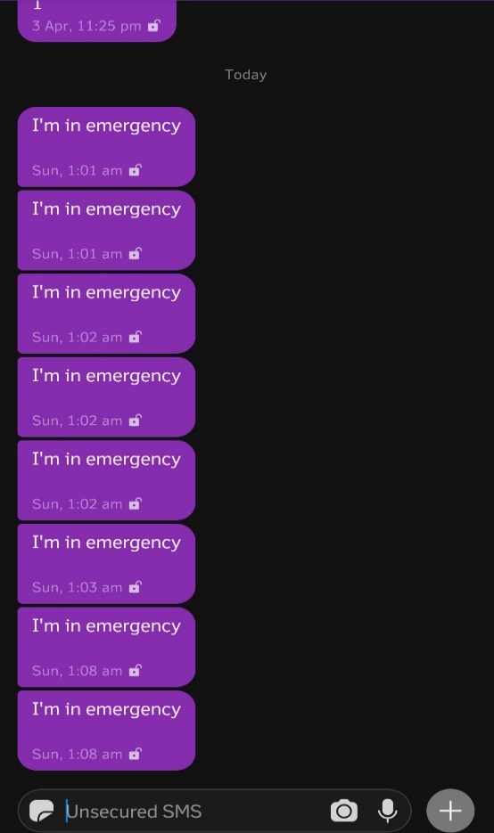
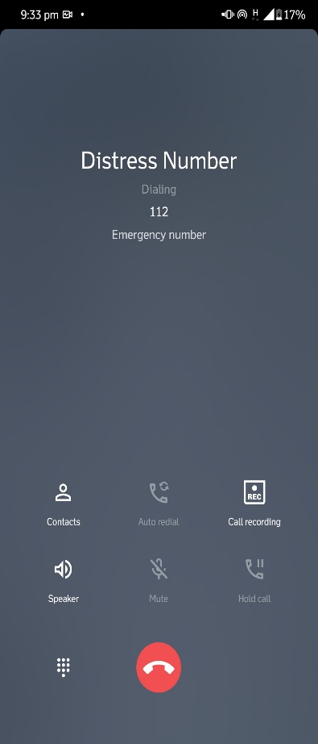
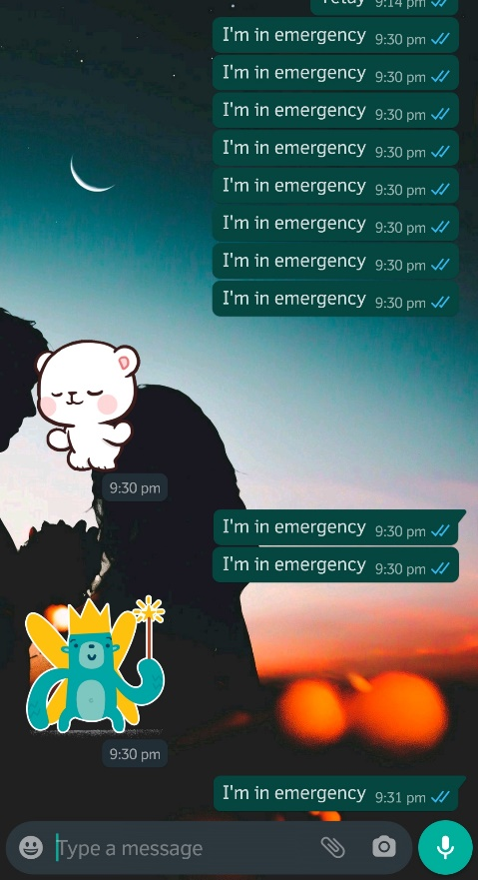
Output Screens:
Text SMS
Call Screen
WhastsApp MSG

Slide 14
Thank You

